Slide 1
Assembly Function recognition (AFR) in embedded systems independent architecture
Mr. Matan Avitan
matanavtian100@gmail.com
Prof. Zeev (Vladimir) Volkovich
May 2019

Slide 2
</Abstract>
Function identification is a fundamental challenge in reverse engineering
01
Many manufacturers use Open Source library code to develop their products and this is one of the most prominent principles in software engineering called reuse
02
The open source code embedded in their products as one or more binaries files
03

Slide 3
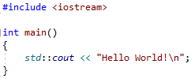
Hello world Program

Slide 4
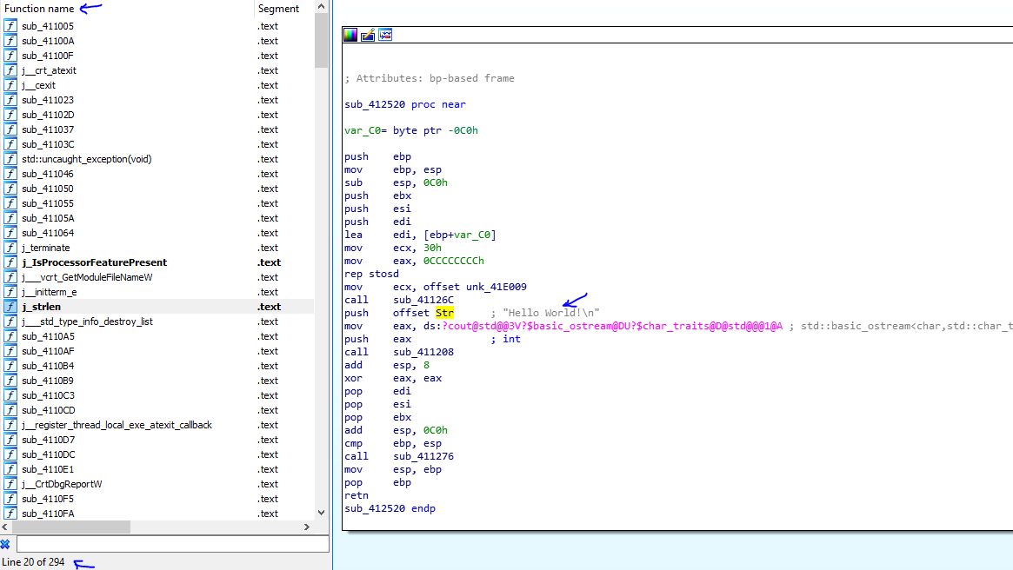
Hello world Program
contains:
294 library functions
1 function main()

Slide 5
</The Need>
When we decode those binary, we get the original assembly code which is running in the product
The need arises for easier and faster code analysis
We want to identify library functions more easily (in automatic process) without reading them

Slide 6
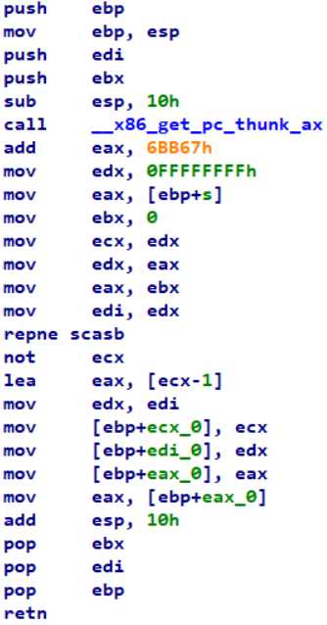
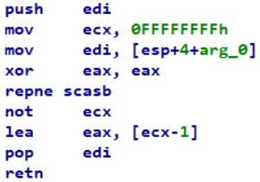
strlen function
Debug
Optimize

Slide 7
strlen function
Debug
Optimize

Slide 8
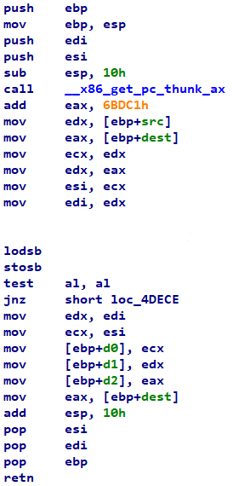
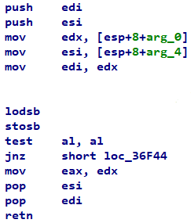
strcpy function
Debug
Optimize

Slide 9
strcpy function
Debug
Optimize

Slide 10


</My Thesis Question>
How to adjust between the assembly optimize function taken from the product and the assembly function is known to compile in a debug environment downloaded from open source repository independent architecture?

Slide 11
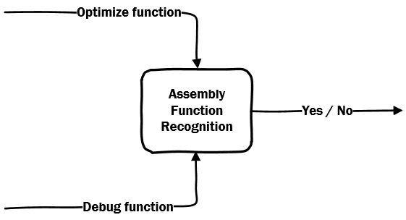
Purpose
How to match (static analysis) between the assembly function (optimize function) taken from the product and the assembly function is known to compile in a debug environment taken from the debug environment
I will answer this question regardless of the type of architecture

Slide 12
</Investigation Process>
Literature Survey
Investigation, Writing Theory
Implementation
Statistics

Slide 13
</Literature Review>
Related Works

Slide 14

Similarity of Binaries Through Re-Optimization
Yaniv David, Nimrod Partush, Eran Yahav
Technion, Israel

Slide 15
Similarity of Binaries through Re-Optimization
Present a scalable approach for establishing similarity between stripped binaries
It works by decomposing binary procedures to comparable fragments and transforming them to a canonical, normalized form using the compiler optimizer, which enables finding equivalent fragments through simple syntactic comparison
They use a statistical framework built by analyzing samples collected “in the wild” to generate a global context that quantifies the significance of each pair of fragments and uses it to lift pair wise fragment equivalence to whole procedure similarity

Slide 16
Similarity of Binaries through Re-Optimization
mov x0, x20
add x0, x0, 1
sub x21, x21, x0
cmn x21, 2
t0 = load r0
t1 = add t0, 1
store t1, r1
...
Lift
Normalize
LLVM
t0 = load x20
store t0, x0
t1 = load x0
t2 = 1
t3 = add t1, t2
store t3, x0
...
t0 = load x20
t1 = add t0, 1
store t1, x0
...
Optimize

Slide 17

Dynamic Approaches
Blanket execution technique in a system called BLEX
Dynamic method where the procedures are executed using random values and the resulting environment is compared.
Limited because the executable may not be easily run externally
Code Coverage Problem
Manuel Egele, Maverick Woo, Peter Chapman, and David Brumley, Carnegie Mellon University

Slide 18

Structure-based static methods
Attempt to fingerprint binary procedures using the sequence of system calls used in the procedure
This approach is unstable to patching and is only applicable to procedures which contain no indirect calls or use system calls directly
Approach for finding similarity using expression trees and their similarity to each other
This approach is vulnerable to code-motion and is not suited to cross-compiler search as the different compilers generate different calculation “shapes” for the same calculation

Slide 19
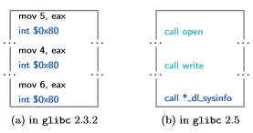
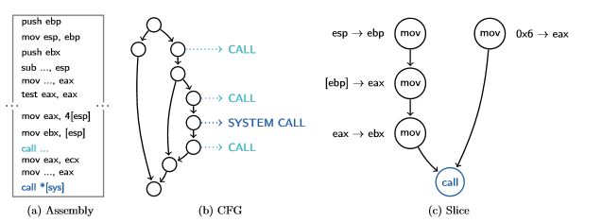
Structure-based static methods

Slide 20
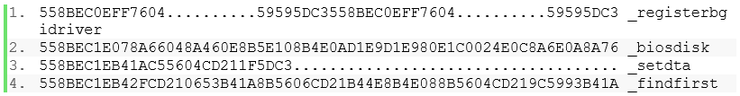
F.L.I.R.T
Fast Library Identification and Recognition Technology
Developed by Hex-Rays and implemented in IDA software
Allows to recognize standard library functions generated by supported compilers and greatly improves the usability and readability of generated disassembly’s

Slide 21
</Research Approach>
Feasibility Study and Theory

Slide 22
</Research Approach>
We assume that there is a similarity between optimize and debug functions
We need to find features to comparison between two functions
Collect the features in a single formula
Solution optimization problem
Finding barriers (top and bottom) in favor of classification

Slide 23

</Similarity Features>
Mnemonic match
$$P\left(x\right)=\frac{\# of containment commands}{\# of command in release function}$$
Command rare match
$$P\left(x\right)=\frac{\# of times exist in debug }{\# of rare mnemonic commands mnemonic}$$
Constant match
$$P\left(x\right)=\frac{\# of times exist in debug }{\# of constants commands }$$
Nested function match
$$P\left(x\right)=\frac{\# of times exist in debug and release }{\# of call nested function in debug }$$
Jump match
$$P\left(x\right)=\frac{\#of jumps without condition in release function}{\#of jumps without condition in debug function}$$

Slide 24
strlen function
Debug
Optimize

Slide 25
strlen function
Debug
Optimize

Slide 26

How to Determine the Similarity ?
We will add weight parameters !

Slide 27
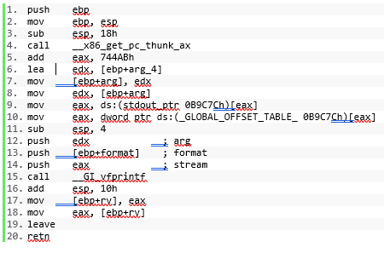
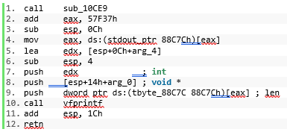



Weights - Definition
$${func}_{D\left(i\right)}$$
The main Question translated to formula
The formula based on weights and features
Every $k$ feature will mark as $P_{k}$
It is very easy to calculate
My mission is to find the $W_{k}$
${sim}_{({func}_{D\left(j\right)},{ func}_{O(k)})}=\sum{W_{k}P_{k}}$
$${func}_{O\left(j\right)}$$

Slide 28

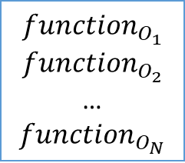
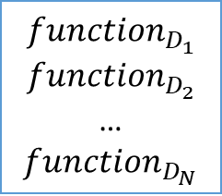


$${function}_{D_{1}}$$
$${function}_{D_{2}}$$
…
$${function}_{D_{N}}$$
$$Debug$$
$$Optimize$$
$${function}_{O_{1}}$$
$${function}_{O_{2}}$$
…
$${function}_{O_{N}}$$

Slide 29
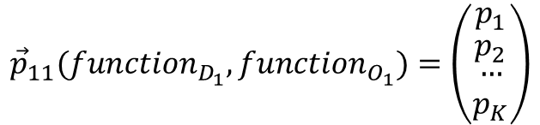
$${function}_{D_{1}}$$
$${function}_{D_{2}}$$
…
$${function}_{D_{N}}$$
$$Debug$$
$${\vec{p}}_{11}({function}_{D_{1}},{function}_{O_{1}})=\left(\begin{matrix}p_{1} \\ \begin{matrix}p_{2} \\ \begin{matrix}… \\ p_{K}\end{matrix}\end{matrix}\end{matrix}\right)$$
$$Optimize$$
$${function}_{O_{1}}$$
$${function}_{O_{2}}$$
…
$${function}_{O_{N}}$$

Slide 30
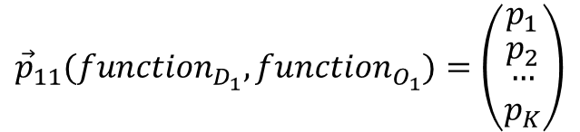

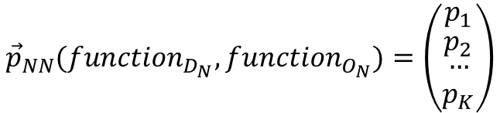
$${function}_{D_{1}}$$
$${function}_{D_{2}}$$
…
$${function}_{D_{N}}$$
$$Debug$$
$${\vec{p}}_{11}({function}_{D_{1}},{function}_{O_{1}})=\left(\begin{matrix}p_{1} \\ \begin{matrix}p_{2} \\ \begin{matrix}… \\ p_{K}\end{matrix}\end{matrix}\end{matrix}\right)$$
$$……$$
$${\vec{p}}_{NN}({function}_{D_{N}},{function}_{O_{N}})=\left(\begin{matrix}p_{1} \\ \begin{matrix}p_{2} \\ \begin{matrix}… \\ p_{K}\end{matrix}\end{matrix}\end{matrix}\right)$$
$$Optimize$$
$${function}_{O_{1}}$$
$${function}_{O_{2}}$$
…
$${function}_{O_{N}}$$

Slide 31
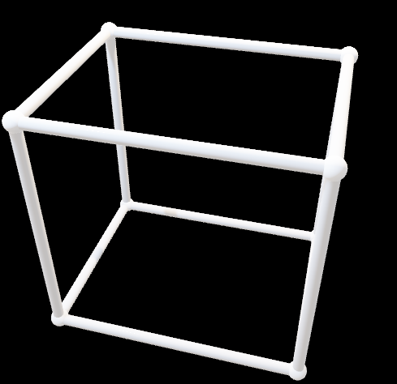
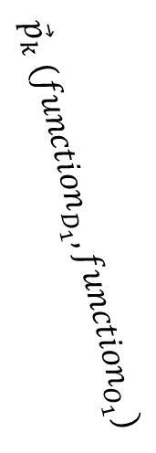




$${function}_{D_{i}}$$
$$Debug$$
$${function}_{O_{j}}$$
$$Optimize$$
$${\vec{p}}_{k} ({function}_{D_{1}},{function}_{O_{1}})$$

Slide 32


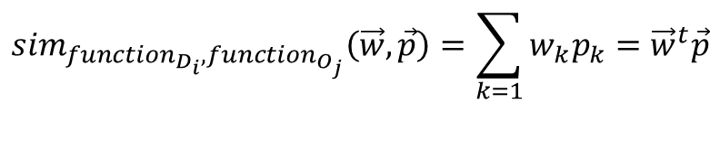
$${function}_{D_{i}}$$
$$Debug$$
$${function}_{O_{j}}$$
$$Optimize$$
$${\vec{p}}_{k} ({function}_{D_{1}},{function}_{O_{1}})$$
$$\dim{=3}$$
$$sim$$
$${sim}_{{function}_{D_{i}},{function}_{O_{j}}}\left(\vec{w},\vec{p}\right)=\sum_{k=1}{w_{k}p_{k}={\vec{w}}^{t}\vec{p}}$$

Slide 33


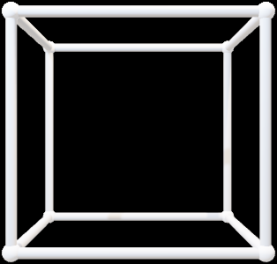


$$Symmetric Diagonally Dominant matrix(SDD)$$
$${function}_{D_{i}}$$
$${function}_{D_{i}}$$
$${function}_{O_{j}}$$
$$Debug$$
$${function}_{O_{j}}$$
$$Optimize$$
$${\vec{p}}_{k} ({function}_{D_{1}},{function}_{O_{1}})$$
$$\dim{=2}$$
$$\dim{=3}$$
$$sim$$
$$sim$$
$${sim}_{{function}_{D_{i}},{function}_{O_{j}}}\left(\vec{w},\vec{p}\right)=\sum_{k=1}{w_{k}p_{k}={\vec{w}}^{t}\vec{p}}$$

Slide 34

Weights Optimization Problem
Every weight will be positive
$${0≤w}_{i}| 1≤i≤K$$
$$\sum_{i=1}{w_{i}}=1| 1≤i≤K$$
Every feature will be probabilistic value
$${0≤P}_{i}≤1$$

Slide 35

SDD 𝑆𝑦𝑚𝑚𝑒𝑡𝑟𝑖𝑐 𝐷𝑖𝑎𝑔𝑜𝑛𝑎𝑙𝑙𝑦 𝐷𝑜𝑚𝑖𝑛𝑎𝑛𝑡
$$x_{ii}≥\sum_{i≠j}{\left|x_{ij}\right|}⇒x_{ii}−\sum_{i≠j}{\left|x_{ij}\right|}≥0$$
Note that: $x_{ij}={\vec{w}}^{t}{\vec{p}}_{ij}$
$${\vec{w}}^{t}{\vec{p}}_{ii}−\sum_{i≠j}{{\vec{w}}^{t}{\vec{p}}_{ij}}≥0⇒{\vec{w}}^{t}({\vec{p}}_{ii}−\sum_{i≠j}{{\vec{p}}_{ij}})≥0$$
Define: $\left({\vec{p}}_{ii}−\sum_{i≠j}{{\vec{p}}_{ij}}\right)≜v_{i}$
$${\vec{w}}^{t}v_{i}≥0 | 1≤i≤N$$
$\text{Define}\text{:} \vec{V}=\left\{v_{1},v_{2}, …,v_{N}\right\}⇒{\vec{w}}^{t}\vec{V}$

Slide 36

Define Optimization Problem
$$\left(0\right) {\vec{w}}^{t}\vec{V}≥0$$
$(2)$ max C
$$s.t.$$
$${\vec{w}}^{t}\vec{V}−C≥0$$

Slide 37
</Design>
Algorithm Implementation

Slide 38

</Algorithm>
$FPremitives$ – Contain the primitive functions that not included branches to other internal functions
$FNPremitives$ – Contain the non-primitive functions that included branches to other internal functions
$W_{k}$ - Describe the weight given to feature k
${func}_{O(i)}$ – Describe the optimize function number $i$ as we want to identify
${func}_{D(i)}$ – Describe the debug function number $i$ from debug library as we want to check similarities

Slide 39

</Algorithm>
$P_{k({func}_{D\left(i\right)},{ func}_{O(j)})}$ – Describes the probability of similarities given two functions ${func}_{D(i)}$ and ${func}_{O(j)}$. That similarities based on feature number $k$
${sim}_{({func}_{D\left(i\right)},{ func}_{O(j)})}$ – It’s a value indicate the probability to similarity between ${func}_{D\left(i\right)}$ and ${func}_{O(j)}$.
$${sim}_{({func}_{D\left(i\right)},{ func}_{O(j)})}=\sum{W_{i}P_{i}}$$

Slide 40
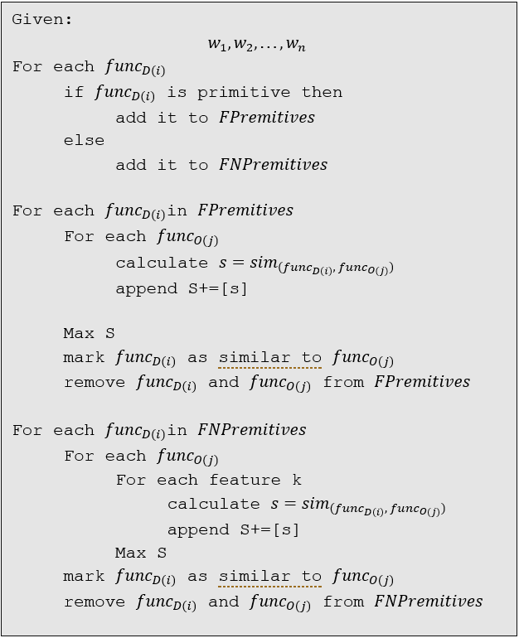
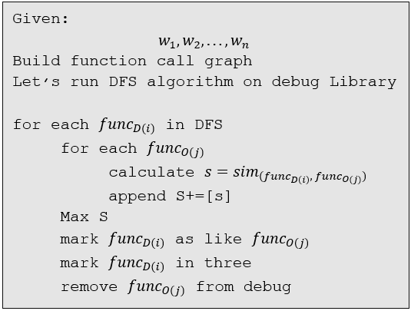
Algorithm - Iterative and Recursive

Slide 41
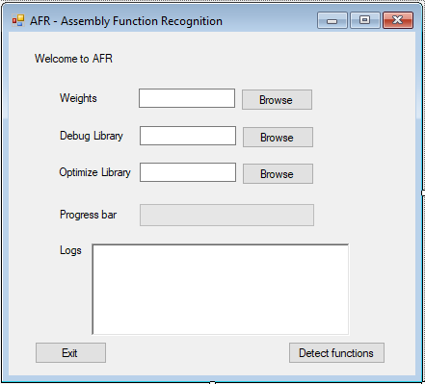
GUI

Slide 42
</Statistics>
TBD in the next semester

Slide 43
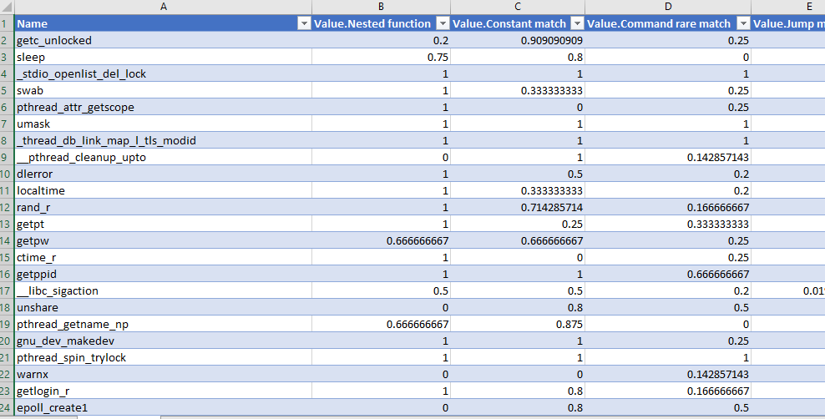
Final Grades

Slide 44
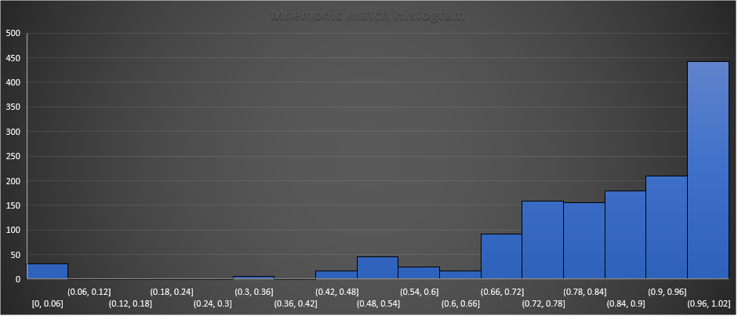
Mnemonic match

Slide 45
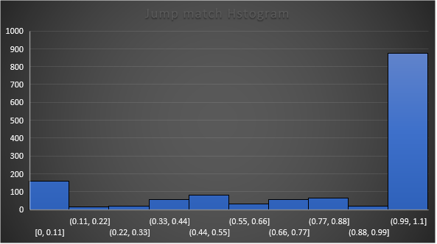
Jump match

Slide 46
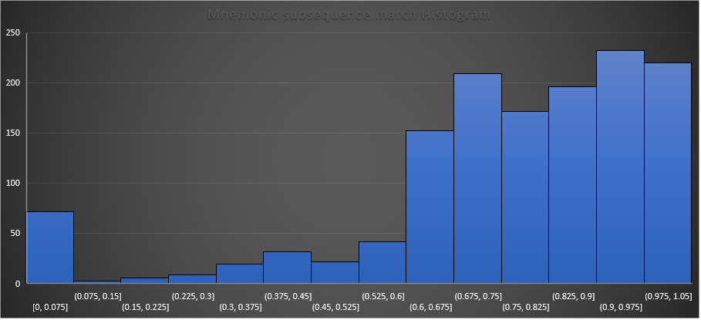
Mnemonic subsequence match

Slide 47
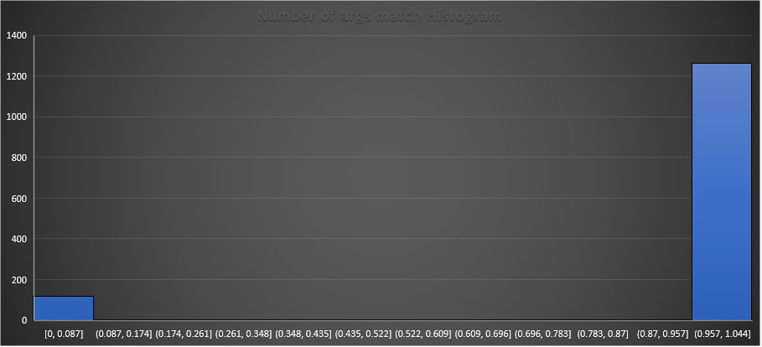
Number of args match

Slide 48
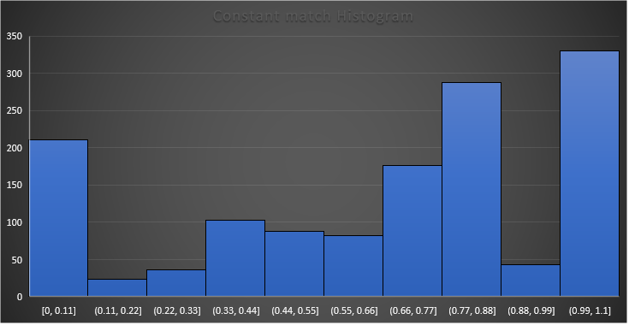
Constant match Histogram

Slide 49


AFR Thank You ! https://github.com/MatanAvitan100/AFR matanavtian100@gmail.com
Mr. Matan Avitan
Prof. Zeev (Vladimir) Volkovich
May 2019

